Slide 1
Realizing self-determination rights of people with disabilities through development practice A case study on the water and sanitation sector in Tanzania 4.9.2015 Helsinki, Finland Nathaly Guzman
www.abilis.fi
Notes:
My study will focus on water and sanitation projects/programmes sponsored by Nordic countries (especially Finland) and implemented by local organizations in Tanzania.
The study aims at evaluating the sanitary situation of persons with disabilities (PWDs) living in this country, and it intends to study the way how Nordic development practice has understood the self-determination rights of Tanzanian PWDs and has ensured the inclusion of PWDs in the different development initiatives.
By analyzing the data collected, the research aims at producing suggestions for development practice to help promoting and realizing self-determination rights of PWDs and to contribute to the reduction of inequalities.

Slide 2
Content
www.abilis.fi
Background
Theoretical frameworks
Research questions
Methodology
Preliminary Findings of Fieldwork in Tanzania
Concluding Remarks

Slide 3
Background
www.abilis.fi
MDGs and Access to Water and Sanitation: Access of persons with disabilities has not been paid attention to.
Finnish ODA less than 1% to disability-specific projects, while 99% of mainstream projects, including WASH projects, hardly include persons with disabilities.
Notes:
The global situation of the access to water and sanitation has been improving during the period of the Millennium development goals.
The world has met the target of halving the proportion of people without access to improved sources of water, five years ahead of schedule
However, little attention has been paid to the need of such access for PWDs.
For example, in slum urban areas, sanitation facilities tend to be public and such premises hardly ever contemplate the needs of persons with disabilities. Consequently, many persons with disabilities are obliged to relieve themselves by using inadequate methods, such as defecating in plastic bags, which creates health threats for themselves and the community where they live.
Moreover, it is hard to know the exact number of PWDs who face barriers when accessing sanitation services because disability-related data is rarely collected and usually household surveys tend to enquire and monitor the sanitation coverage only at a household level without paying attention to individual needs within the household.
As a result, development initiatives have had the risk of been increasing inequalities of people with and without disabilities
It has been only recently that development programmes have started to pay attention to this issue at least at the policy level. However, efforts have been limited and for example still today, the Finnish Official Development Aid targets less than 1% of budget to disability related projects and 99% of projects hardly ever include PWDs.

Slide 4
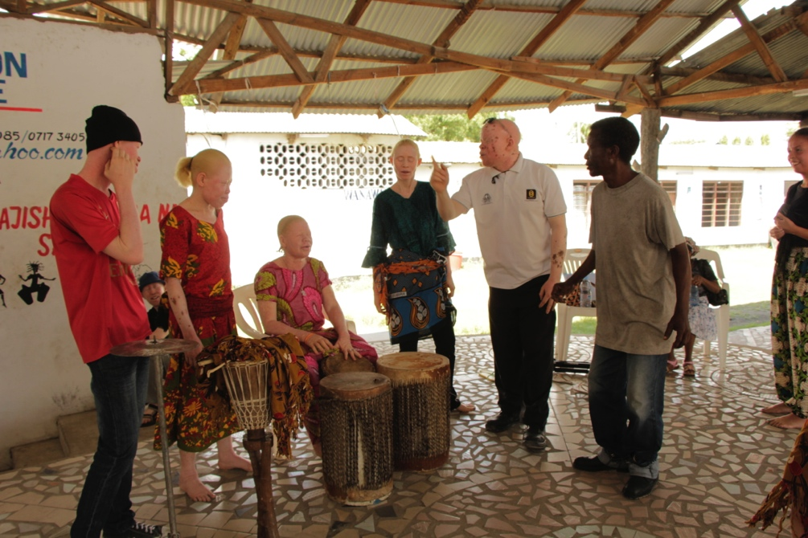
Theoretical Frameworks
Human Rights Based Approach
Self-determination
Notes:
This study is based on the human rights-based approach (HRBA) to development, a conceptual framework that has two goals:
To strengthen the capacity of duty bearers so they can respect, protect and fulfil their human rights obligations
To empower rights holders so they are capable to demand and claim for their human rights to be respected, protected and fulfilled.
The HRBA is based on six core principles: participation, accountability, equality and non-discrimination, transparency, and empowerment. Such principles should be taken into account for programming, legislation, policy and implementation at all levels and between all actors.
The Nordic countries have been applying the HRBA to their development policy for years. For example:
Sweden and Denmark identify non-discrimination, participation, transparency and accountability as the core principles of their human rights-based approach to development
Finland states that universality, self-determination, non-discrimination and equality guide its development policy programme.
In addition, the HRBA to development has a great variety of suggestions to development work related with disability and to its operationalization. For instance, it calls for rights-based actions instead of charity.
This research is also centered on the concept of self-determination which has been widely studied by international law and it is often associated with the capacity of sovereign states to declare their independent statehood.
However, this concept has started to be regarded as a human right although it has been little explored in the HRBA literature.
In disability studies, self-determination includes several elements such as the ability to communicate and take individual decisions, the ability to control resources to obtain needed services or support, and the opportunity to participate in community activities.
The short background information I gave to you, shows that the self-determination of PWDs has been too frequently watered down in international and development cooperation activities and replaced by for example the representation or consultation of a limited number of PWDs in the best of the cases.

Slide 5
Research questions
How are PWDs included in development projects/programmes on water and sanitation in informal settlements of cities in Tanzania?
What are the challenges to include PWDs into the planning and implementation of development projects, specifically regarding water and sanitation?
What are the prerequisites (elements) for realizing self-determination rights?
How Nordic development practice can reflect a human rights-based understanding of self-determination?

Slide 6
Methodology
www.abilis.fi
Fieldwork in Tanzania (October-November 2014)
- personal and group interviews
- observation of WASH projects
- Focus group dicussions
- literature and unpublished report reviews
Survey to Finnish WASH stakeholders (Spring 2015)
Regular dialogue with relevant NGOs and government authorities (Continuous)
Notes:
So, how I do this?
We have carried out two field works.
- Conducted a survey to Finnish wash stakeholders where we asked about their experiences in including persons with disabilities in their WASH projects/programmes

Slide 7
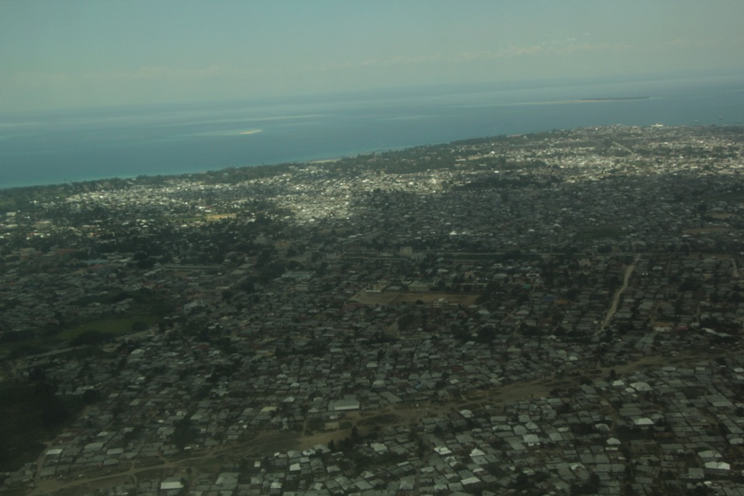
Tanzania-Finland NGO WASH project
www.abilis.fi
Dar es Salaam
Around 4,5 million people.
Around 20% of the population has access to an improved sanitation facility, meaning a facility that is safe and cleanable.
Notes:
There are about 4,5 million people living in Dar es Salaam. Today, less than 20% of the population have access to an improved sanitation facility.
People with disabilities are very affected by this situation, as majority of toilets that are built or improved never take accessibility into account.
80% of the city consists in slums which are very compact areas where it is very challenging to move around…

Slide 8
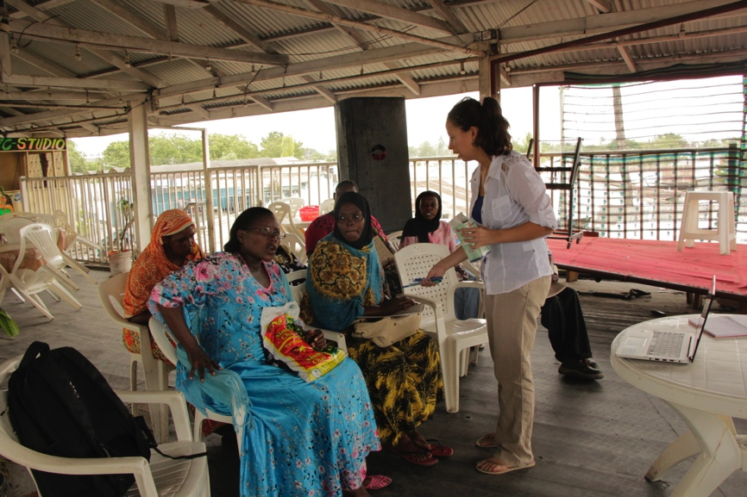
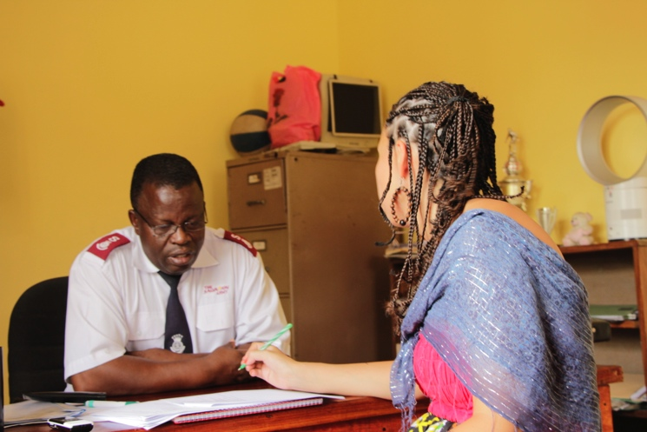
Invisible people
Notes:
My study was carried out in a slum called Keko Machungwa, where I asked a Community based organization working in sanitation and NGO promoting different types of urban improvement activities about the involvement of PWDs in sanitation initiatives. When asked, they accepted it has been very challenging to include PWDs in the planning of sanitation activities and it was even hard for them to think of PWDs living in their communities.
They seem to be willing to include PWDs in their programmes but they also expressed they do not know how to include them, and how they could really participate not only in the planning but in the implementation of the programmes.
In addition, concerning the survey that was made to Finnish wash stakeholders, most of organizations make use of manuals to address needs of vulnerable groups, but no special attention is given to people with disabilities. Organizations express their desire for a manual that deals with strategies to change the attitudes of communities towards disability. A manual/guideline concerning technicalities on accessibility is desired but it is also expected that manual helps to increase participation of PWDs in WASH projects and to train/convince leaders and local actors of the need to include disability in these actions.

Slide 9
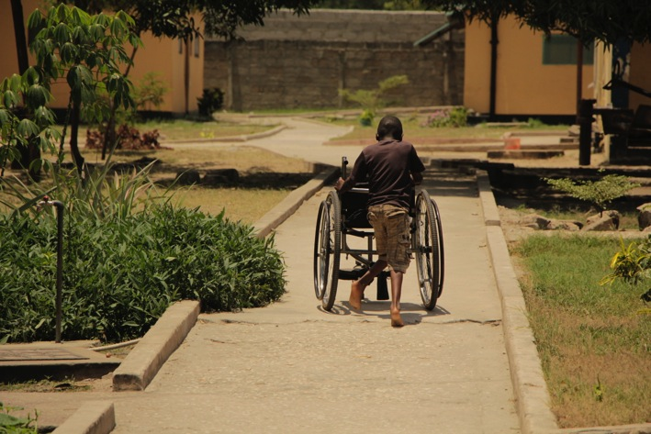
Many root causes for the invisibility
www.abilis.fi
Stigma
Discrimination from community activities
Lack of knowledge/ignorance
No obligation of inclusion
Natural environment
Notes:
Deeply rooted stigma towards disability: people believe it is a curse for the family, negative, then hide their disabled relatives
People with disabilities are discriminated in the community. Many times not included in other community activities and spaces such as market, church, etc.
Lack of knowledge/ignorance of development workers both from foreign organizations and from the country organizations. So they don’t know if there are PWDs around, and if they know, they simply don’t know how to include PWDs
No obligation of inclusion as there are not guidelines or TOR provided by consulting companies, NGOs, donors (only voluntary aspiration). These are partly because there is no available guideline to include pwds in WASH projects. It’s voluntary to include pwds, and consulting companies and NGOs answered in the survey that they do not have their own guideline how to include pwds and rarely pay special attention to the inclusion of pwds.
BUT ALSO, natural environment! Usually PWDs stay at home because slum environment is very inaccessible. Paths are uneven, difficult to move around

Slide 10
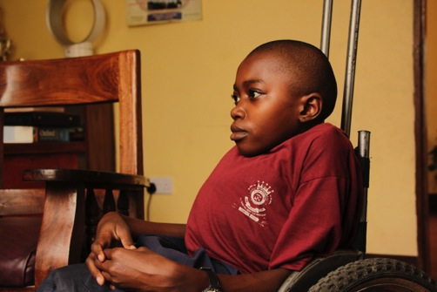
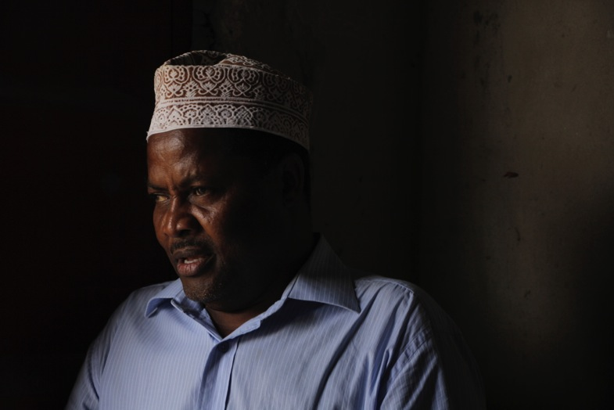
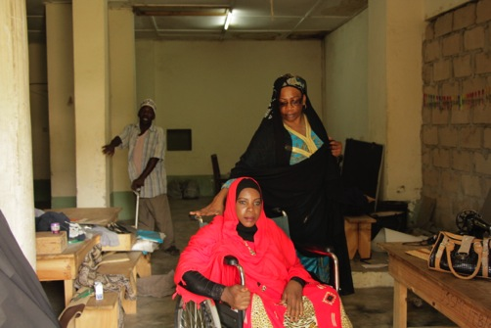
Experiences of persons with disabilities
www.abilis.fi
Notes:
Seven people with disabilities were interviewed in Keko Machungwa.
Regarding access to water services, people were found to have access to a well or a pipe installed nearby their homes. However, collection of water had to be always carried out by a non-disabled household member, due to inaccessible path to go and fetch water, unavailability of mobility aids (wheelchair) and also because of the physical nature of the work.
Concerning access to sanitation facilities the situation is alarming. Four of the people interviewed cannot access the pit latrines available in their households. Therefore they have to use a bucket both to urinate and defecate. Three people explained they can access the household toilet, but they face several barriers every time they use these facilities:
toilet facilities are usually very far away,
with uneven paths
it takes them long time to reach because of their physical impairments.
When they reach the toilet, normally they have to crawl and get filthy because there is nothing to hold onto. All toilets are for squatting so there is not possibility to use a chair to sit. In addition, these people feel very unsafe while using the facilities because there are broken and missing parts (roof, door, toilet slab).
Usually there is no privacy because they need help of someone else to be able to relieve their bodies. Furthermore, there is often not available water to wash or flush, while premises are smelly and dirty.

Slide 11
Action Research
www.abilis.fi
With some Finnish WASH NGO and DPOs, we will publish two guidebooks on WASH and disability
One for WASH stakeholders
The other for DPOs in the global South
Notes:
The situation is not very good. So, this is why we have decided to already embark in some actions during our research:
We are planning to publish handbooks on accessible WASH facilities in the Global South in this autumn together with Kynnys ry, Huussi ry, and Vammaiskumppanuus ry. One is targeted to Finnish WASH actors that have development cooperation projects/programmes, while the other two organizations of persons with disabilities in the Global South.
We are still developing these manuals, so any ideas that might come from the audience are warmly welcome!

Slide 12
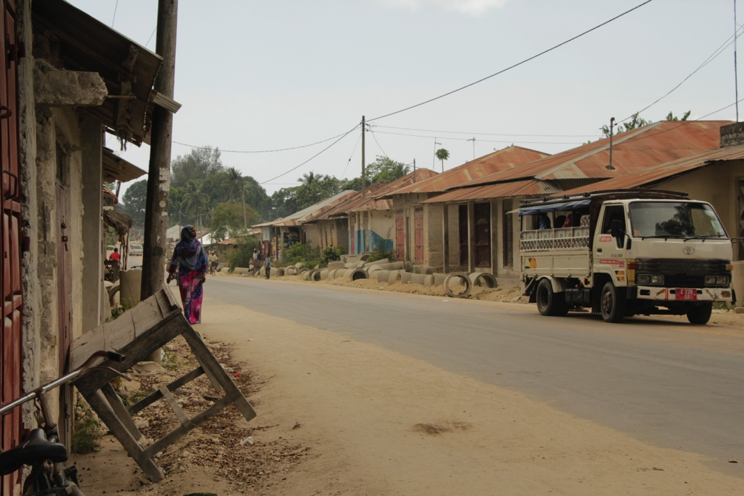
Future Fieldwork
www.abilis.fi
Fieldwork in Tanzania (November 2015)
The same NGO project and others in urban slum areas

Slide 13
THANK YOU!

